Slide 1
PEER8
SPRINT PRESENTATION
Cole, Francisco, Noah, Yhara, Cuinn, and Jannat

Slide 2
BACKGROUND
Tasked with automating the aggregation of scores from peer reviews
Peer reviews used by instructors for grading
Instructors need ability for customization

Slide 3
OVERVIEW
Web application
Instructor/student accounts
Customizable templates for peer reviews
User-friendly dashboards
Auto registration
Instructors can create groups
Instructors can drop students

Slide 4
TABLE OF CONTENTS
01
DIAGRAMS
02
CHALLENGES
03
LESSONS LEARNED
04
DEMO
WBS, Sequence, State, Use-Case, Activity, Database ER

Slide 5
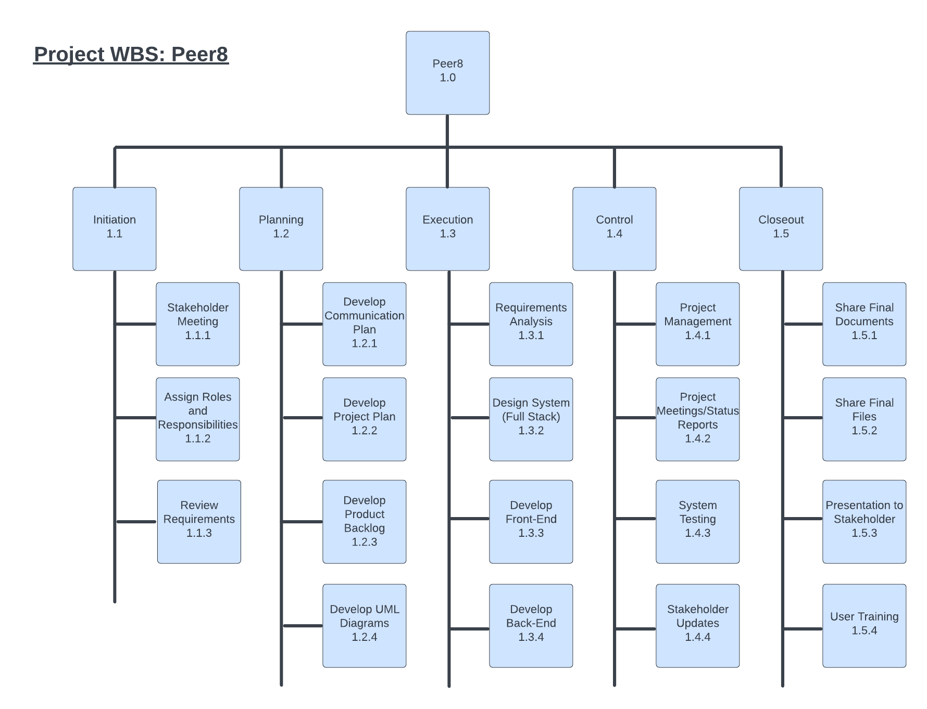

Slide 6
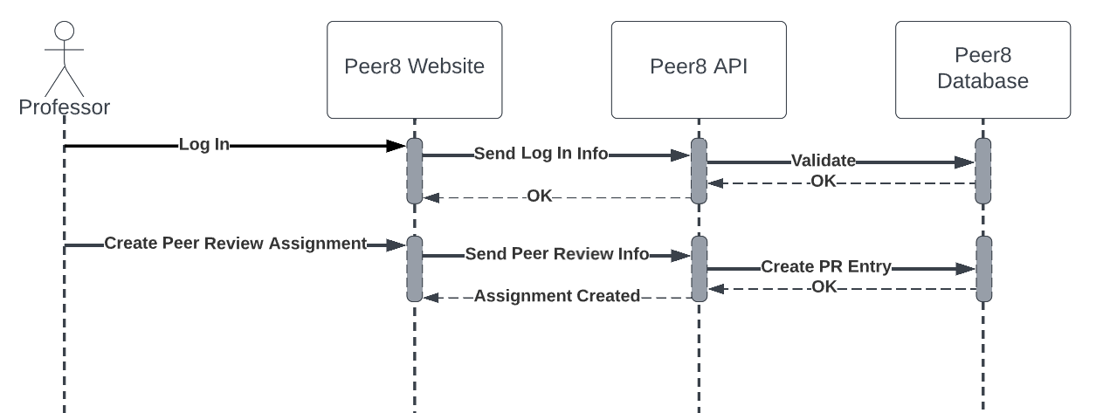
Sequence UML

Slide 7
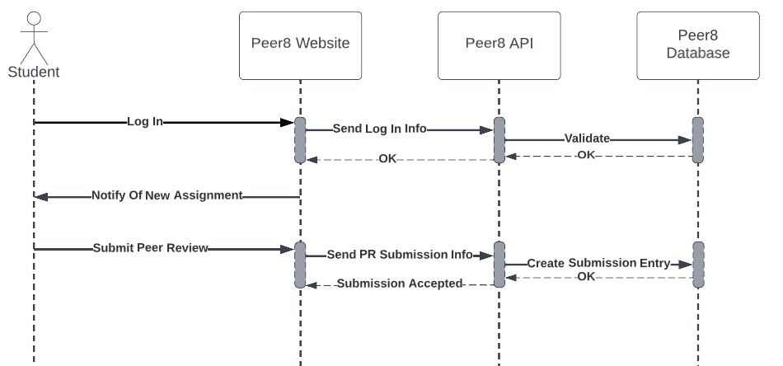
Sequence UML

Slide 8
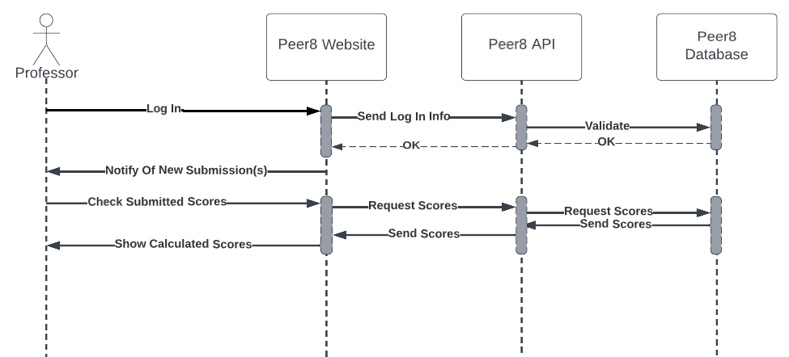
Sequence UML

Slide 9
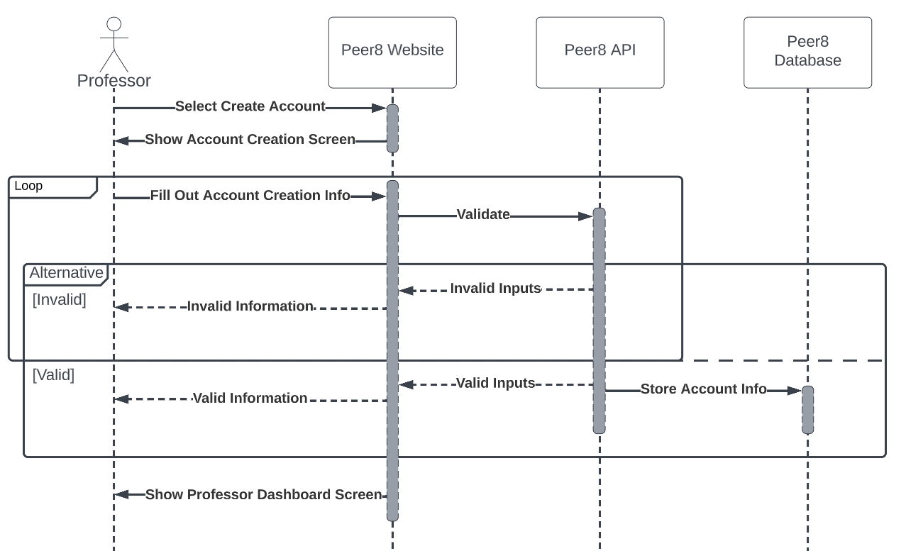
Sequence UML

Slide 10
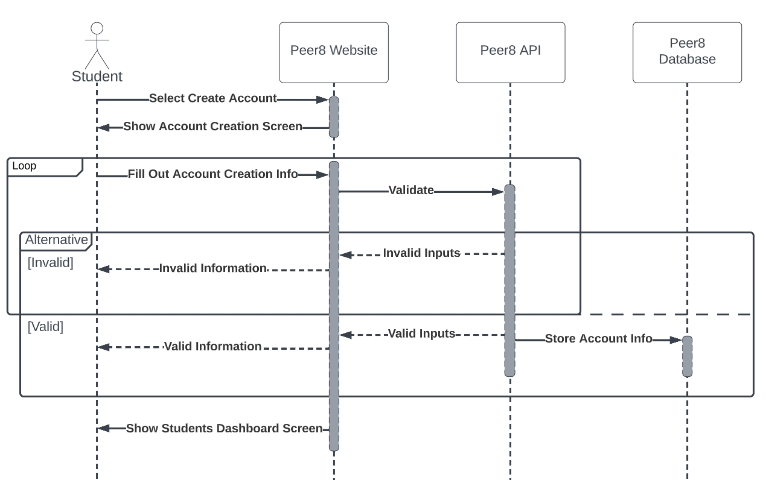
Sequence UML

Slide 11
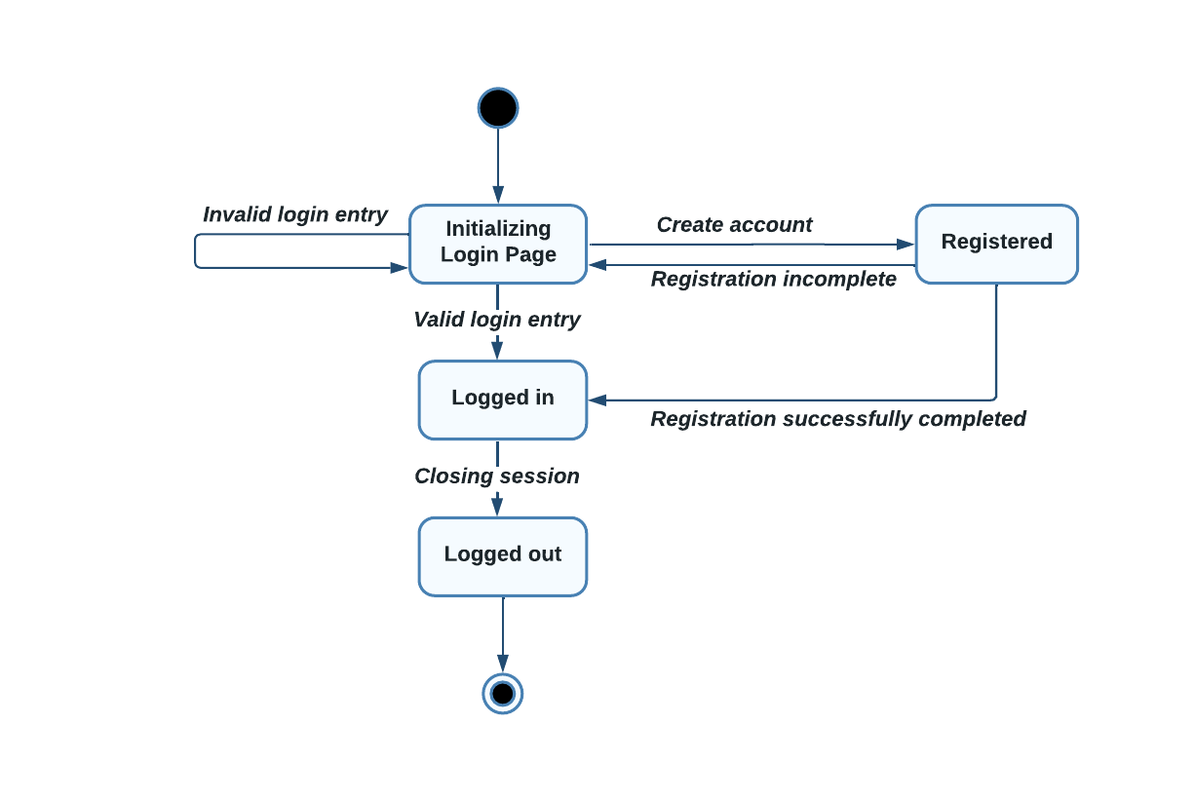
State UML

Slide 12
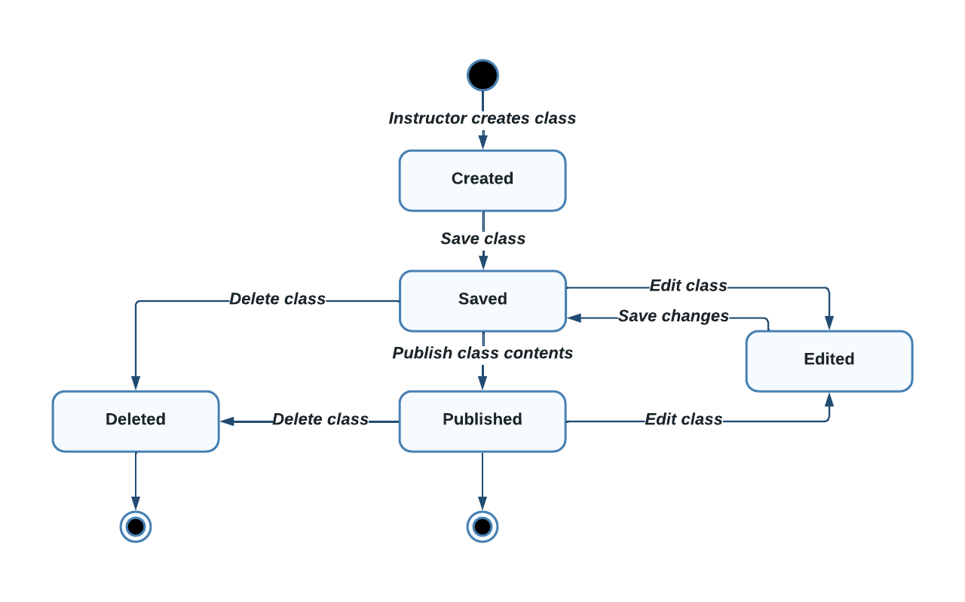
State UML

Slide 13
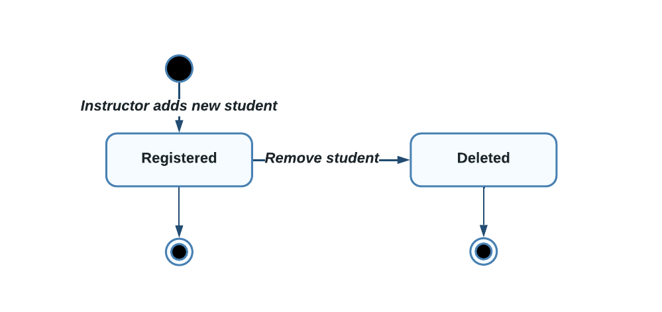
State UML

Slide 14
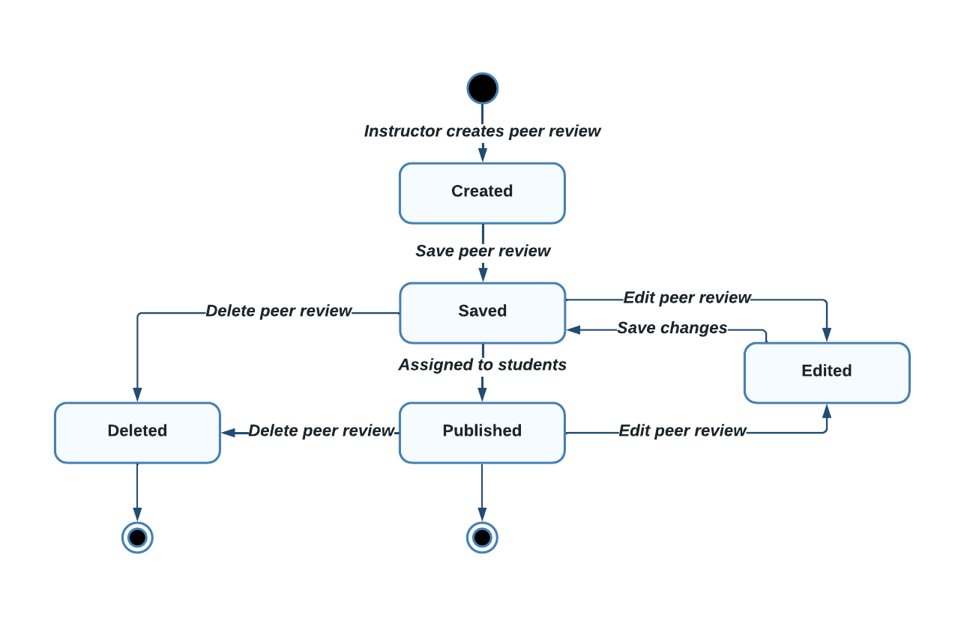
State UML

Slide 15
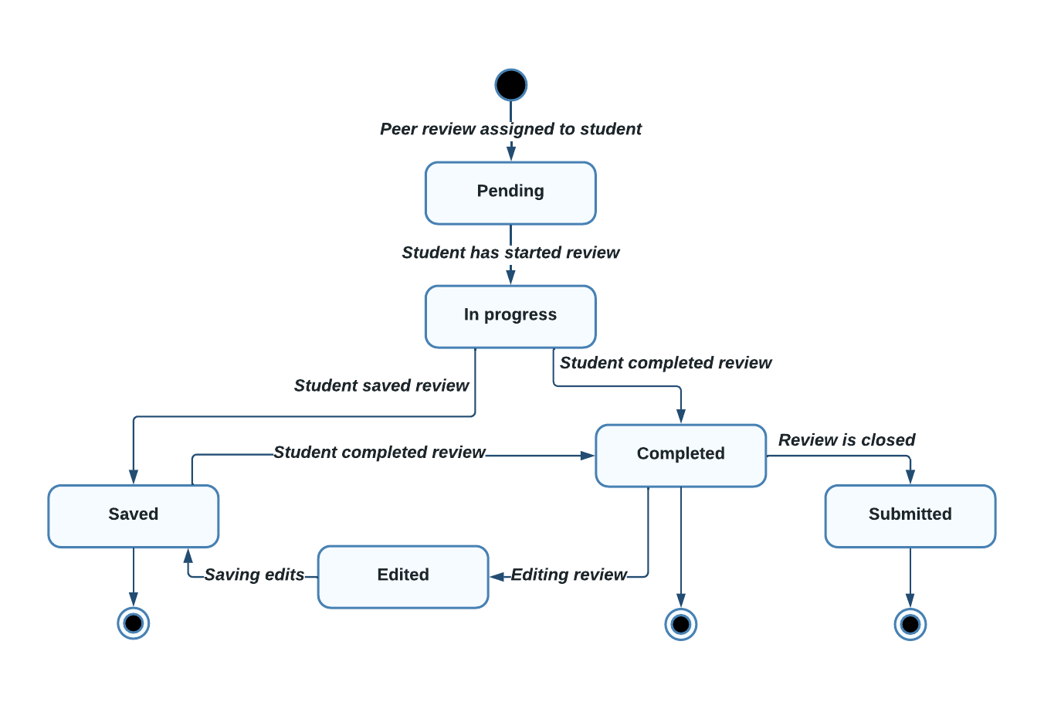
State UML

Slide 16
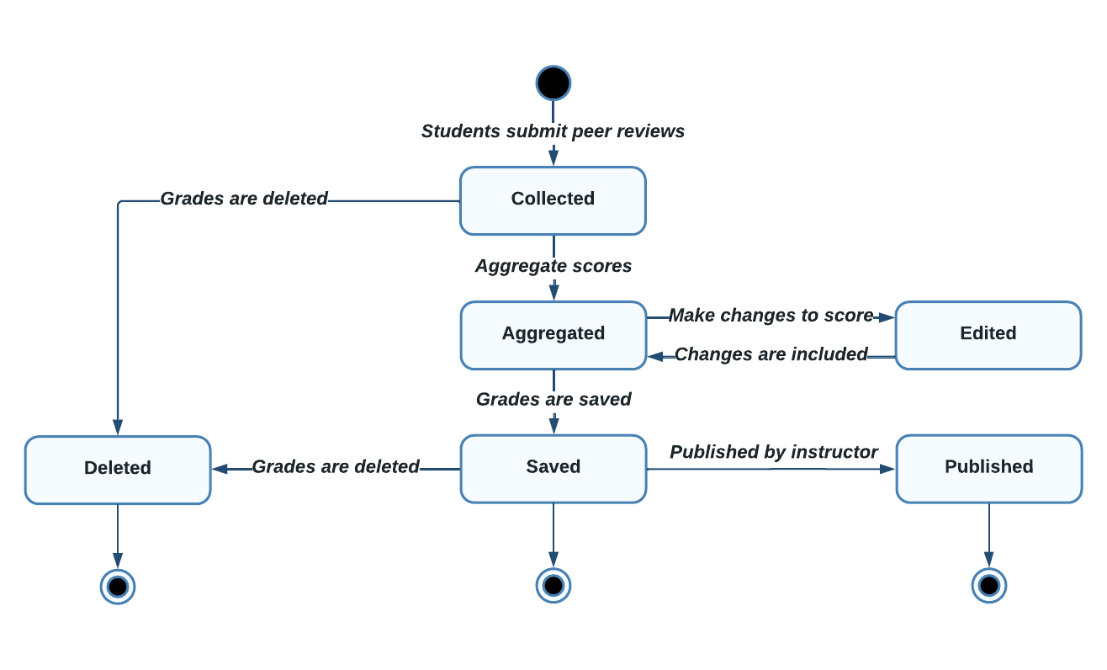
State UML

Slide 17
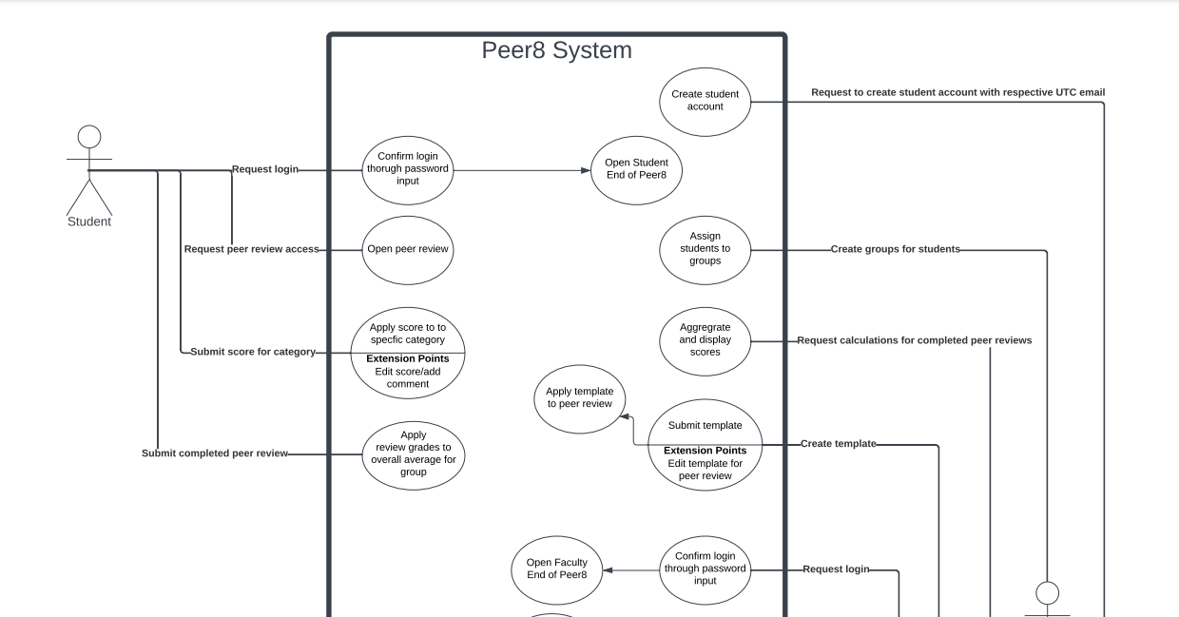
Use-Case UML

Slide 18
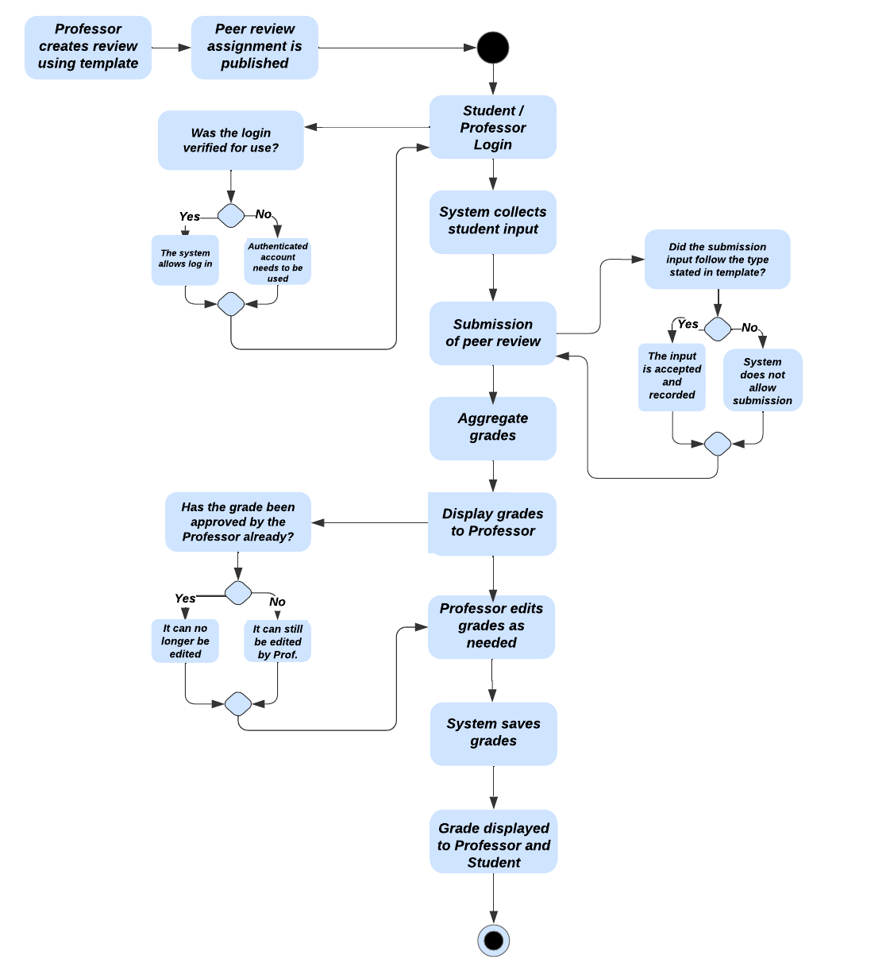
Activity UML

Slide 19
CHALLENGES
Time constraint
Common meeting Times
Miscommunication with certain features
Differentiating between instructors & students

Slide 20
LESSONS LEARNED
Communication is the most important piece of the puzzle
Assign tasks to fit people’s strengths
Implementation of Agile/Scrum methods
Identify issues early, find solutions often

Slide 21
PEER8
DEMO

Slide 22
QUESTIONS?

